Slide 1
SBA Final Project
Donald Bookman, Christopher Gray, Ryan Johnson, Alex Rodriguez

Slide 2
Outline
Project Motivation/Background
Data Description
Data Preparation
Models/Diagrams
Key Findings
Managerial Implications

Slide 3
Project Motivation/Background
What is SBA?
Small Business Administration that assists startups and small businesses.
Provides loans to qualifying businesses
Project goal
Understanding a small business being accepted or denied as well as the statistics of loans being paid off or charged off.

Slide 4
Data Description
A charge-off, also known as a charged-off account, is a debt that has been so overdue that it has been removed off the balance sheet by the creditor.
It still must be paid however and can lower the payers credit report
It indicates the obligation has been unpaid for such a long time that creditors have designated it as a bad debt.

Slide 5
Data Preparation
We changed the starting year for the data from 1997 to 2005
Only used Pennsylvania data
This reduced the row count from around 890,000 rows to about 7,600 rows
We focused on the target variable MIS_Status to determine if the loan will be paid off or charged off

Slide 6
Models/Diagrams

Slide 7
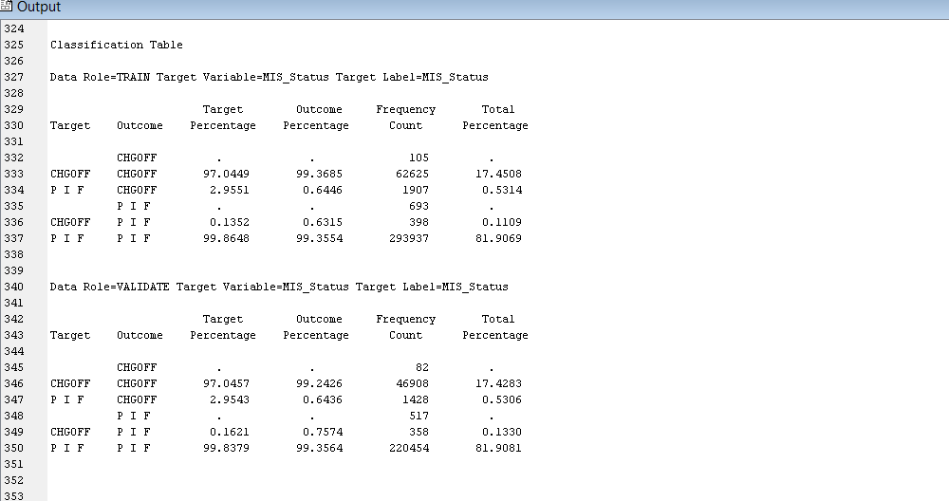
Neural Network

Slide 8
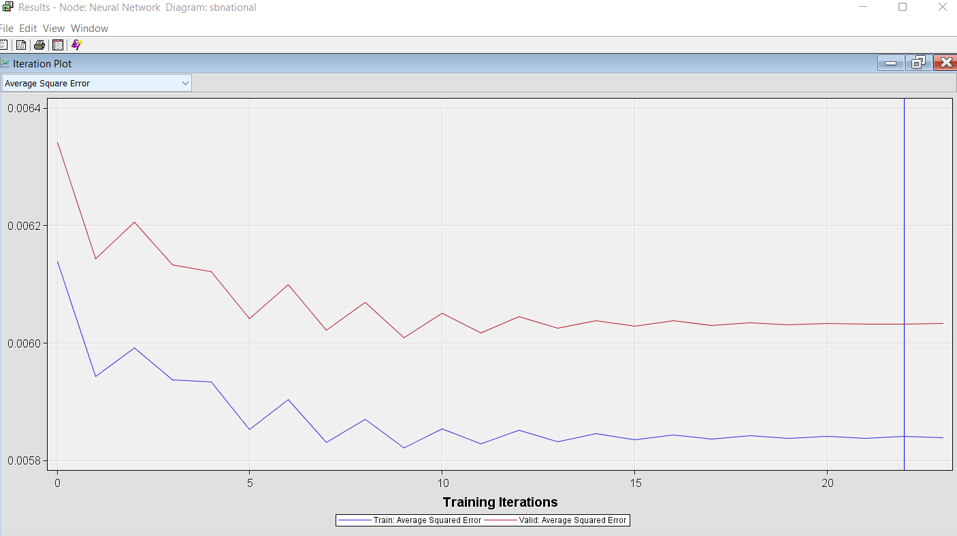

Slide 9
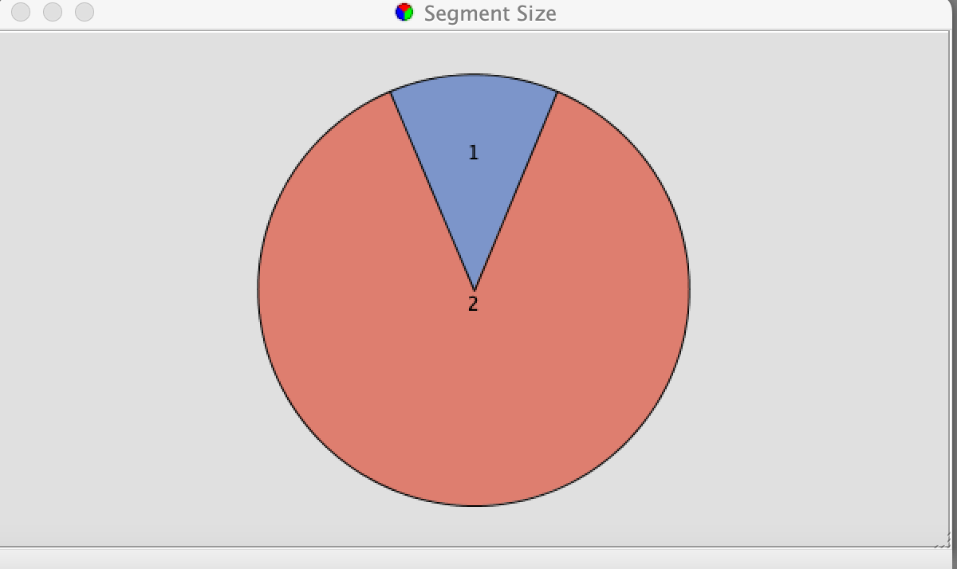
Cluster Analysis 1

Slide 10
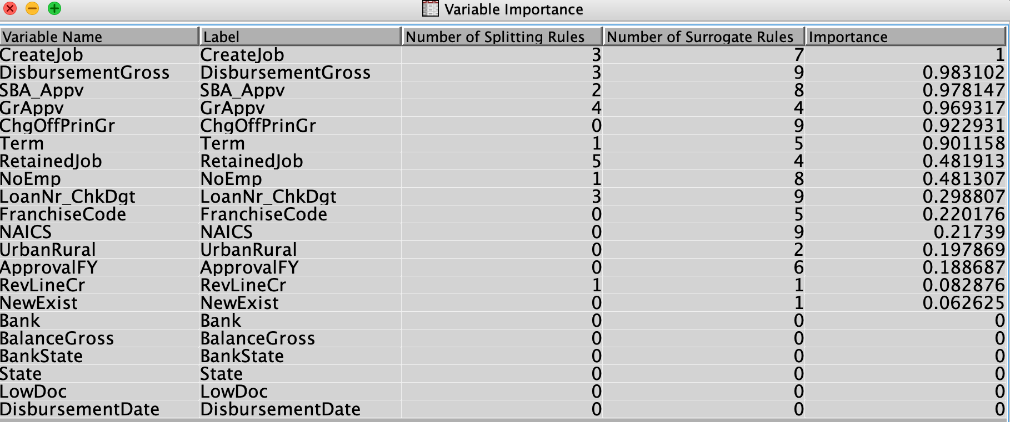
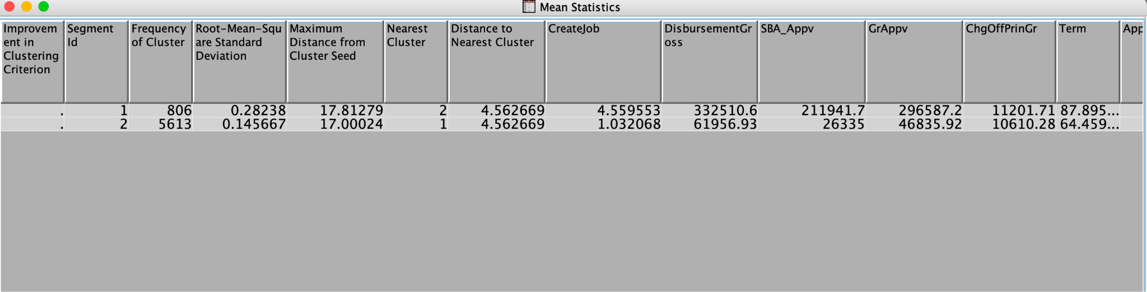
Cluster Analysis 1 Cont.

Slide 11
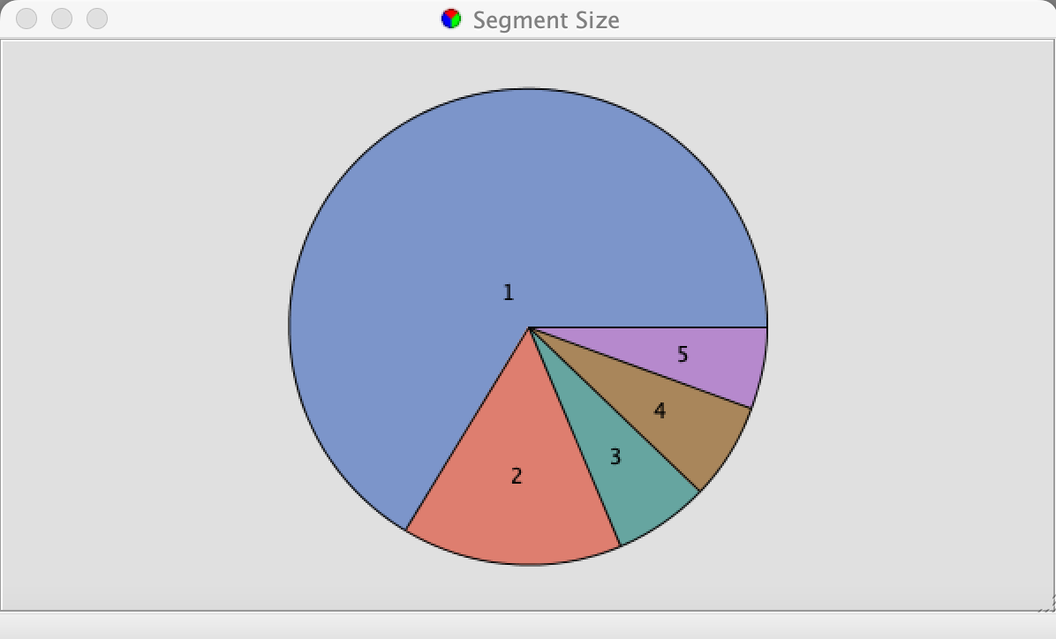
Cluster Analysis 2

Slide 12
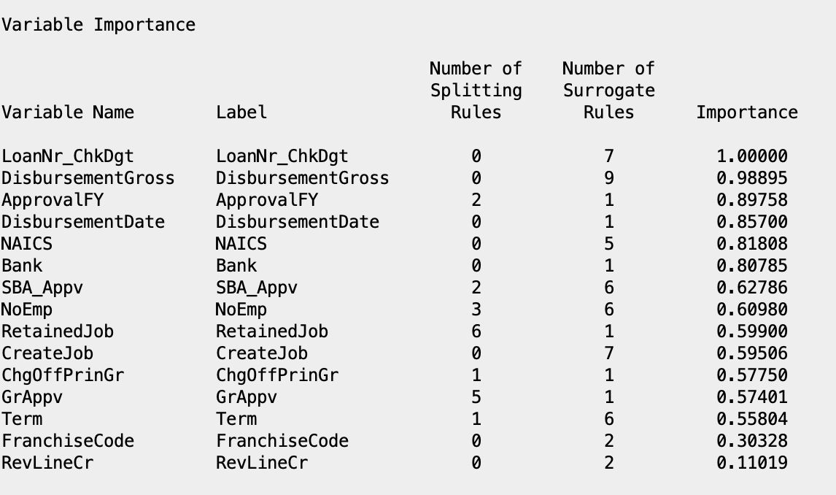

Slide 13
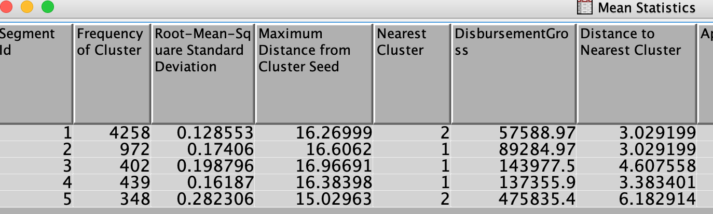

Slide 14
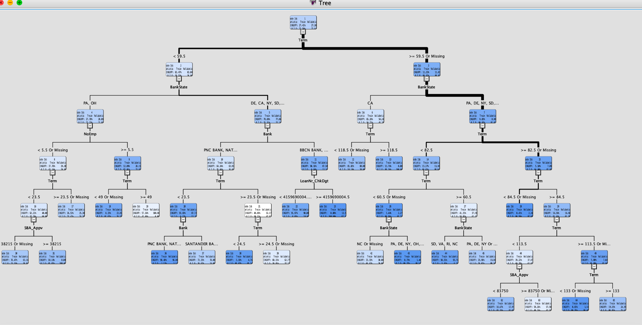
Decision Tree

Slide 15
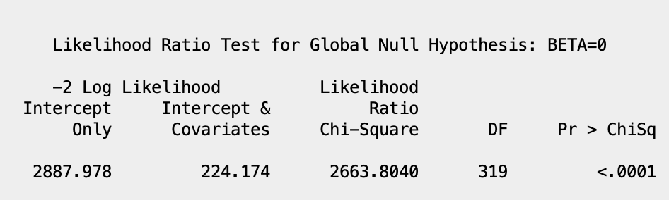
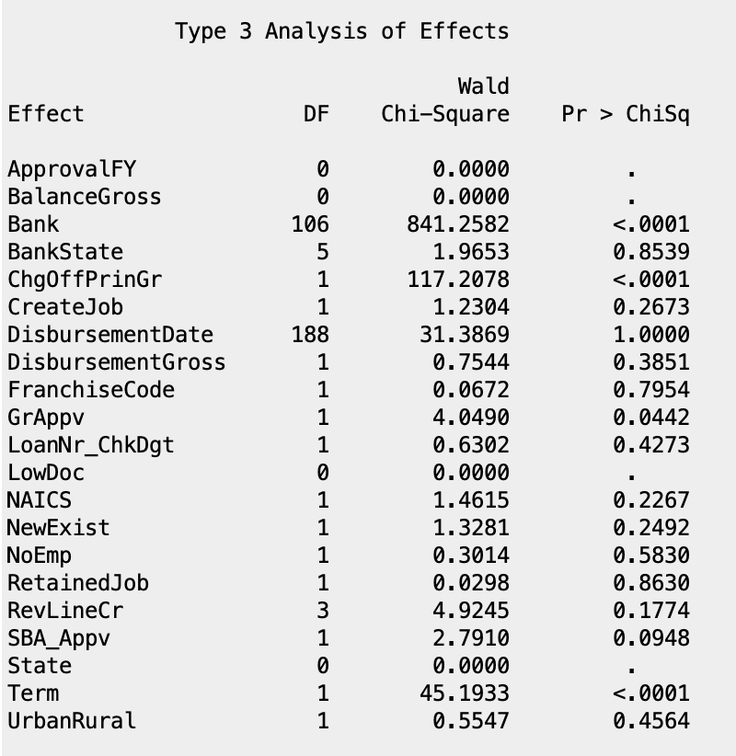
Logistic Regression

Slide 16
Key Findings in Analysis
Target Variable: MIS_Status (whether loan was paid in full or charged off)
Neural Network:
GrAppv (Gross amount approved): larger amount approved, more likely to pay loan in full
Cluster Analysis:
First had 2 clusters, second had 5 clusters
DisbursementGross only variable to have 0.9 VI in both

Slide 17
Key Findings in Analysis
Decision Tree:
Term was the first split, had by far the most VI
Second split based on BankState, CA vs all other states
Logistic Regression:
Bank, ChgOffPrinGr, GrAppv, Term all statistically significant
Overall, Term and GrAppv significant in multiple analyzes, DisbursementGross in both cluster analyses

Slide 18
Managerial Implications
In order to have a full picture of a administrations financial stability, you have to first understand where funds are coming from and how they are being allocated within the administration.
Paying loan accounts in full provides the banks with tangible proof that a specific SBA can manage, pay back, and generate organic revenue from the funds loaned to them; making them more reluctant to loan more funds.
SBA Pennsylvania data analysis provides insight into the lifespan and health of loan agreements enacted by small business administrations with banks. The ability of an administration to overpay, make prompt payments, and pay accounts in full to their partnering bank is proven by the data to be crucial to the overall lack of financial burden a small business administration has (long-term loan debt).
MIS_STATUS -is the target variable managers can utilize to keep track of loan agreements with banks in real time

Slide 19
References
A., & Li, M. (n.d.). "should this loan be approved or denied?": A large dataset with class assignment guidelines. Taylor & Francis. Retrieved May 4, 2022
Can You Get Charge-Offs Erased From Your Credit Reports? (2021, June 4). Investopedia.
Getting Started with SAS(R) Enterprise Miner(TM) 7.1. (2011, November 3). SAS Enterprise Miner Forum. https://support.sas.com/documentation/cdl/en/emgsj/64144/HTML/default/viewer.htm#n1docbb4hkr3nwn1ukqzqmme48yn.htm
Min Li, Amy Mickel & Stanley Taylor (2018) “Should This Loan be Approved or Denied?”: A Large Dataset with Class Assignment Guidelines, Journal of Statistics Education, 26:1, 55-66, DOI: 10.1080/10691898.2018.1434342

Slide 20
Thank you for listening!
Any Questions?

